Slide 1
Genetic Algorithm

Slide 2
Previous Lecture
Components pf Genetic Algorithm
  Encoding principles (gene, chromosome)
  Initialization procedure (creation)
  Selection of parents (reproduction)
  Genetic operators (mutation, recombination)
  Evaluation function
  Termination condition

Slide 3
Practice
For the following generation compute the fitness ratio:
Now perform Roulette wheel selection on the same generation. Assume the random numbers generated for this method are
  (1) 60 (2) 10 (3) 90 (4) 35
Apply crossover on the selected chromosomes in above question. The crossover must be applied from index 3 to index 5 (index starts from 0).
 | Chromosome | F(x) | Fitness | Fitness Ratio
C1 | 65413532 | 12 | 20%
C2 | 87126601 | 50 | 70%
C3 | 23921285 | 5 | 5%
C4 | 41852094 | 1 | 2%

Slide 4
n-Queen Problem

Slide 5
Example: the 8 queens problem
Place 8 queens on an 8x8 chessboard in
such a way that they cannot check each other

Slide 6
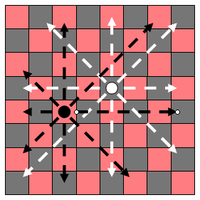
8-Queens Problem
Q
State = position of 8 queens each in a column
  3 4 5 6 1 3 8 7
Start with k randomly generated states (population)
Evaluation function (fitness function).
Higher values for better states.
Produce the next generation of states by “simulated evolution”
Random selection
  Crossover
  Random mutation

Slide 7
The 8 queens problem: representation
Phenotype:
a board configuration
Genotype:
a permutation of
the numbers 1 - 8
Obvious mapping
1
3
5
2
6
4
7
8

Slide 8
8 Queens Problem: Fitness evaluation
Penalty of one queen:
  the number of queens she can check.
Penalty of a configuration:
  the sum of the penalties of all queens.
Note: penalty is to be minimized
Fitness of a configuration:
  inverse penalty to be maximized

Slide 9
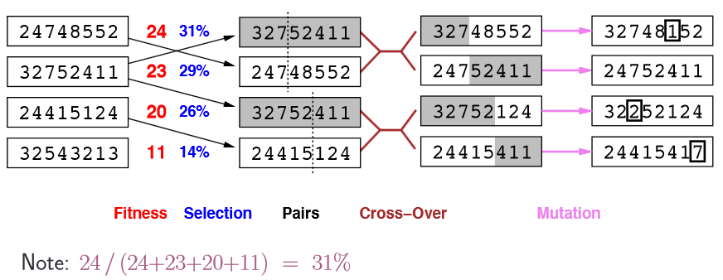
8-Queens Problem

Slide 10
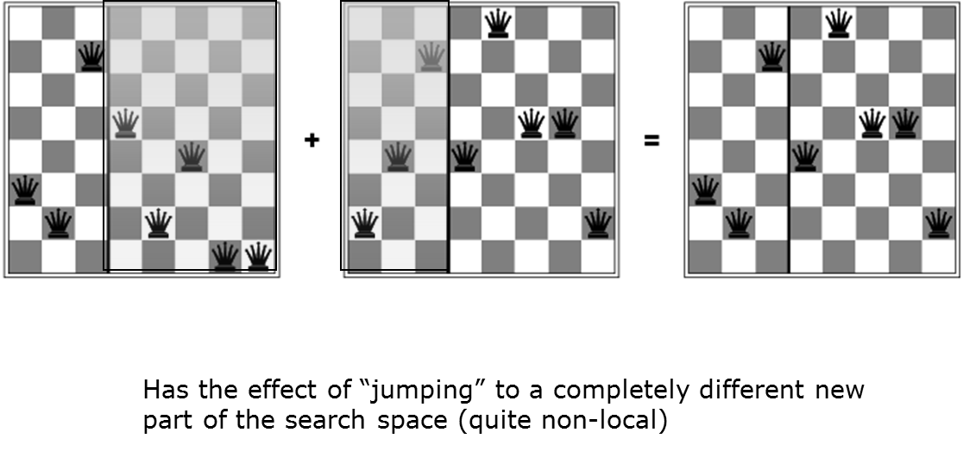
Effect of Crossover on 8-Queens
$$32752411 + 24748552 = 32748552$$

Slide 11
The 8 queens problem: Mutation
Small variation in one permutation, e.g.:
  swapping values of two randomly chosen positions,
1
3
5
2
6
4
7
8
1
3
7
2
6
4
5
8

Slide 12
The 8 queens problem: Recombination
Combining two permutations into two new permutations:
choose random crossover point
copy first parts into children
create second part by inserting values from other parent:
  in the order they appear there
  beginning after crossover point
  skipping values already in child
1
3
5
2
6
4
7
8
1
3
5
4
2
8
7
6
8
7
6
5
4
3
2
1
8
7
6
2
4
1
3
5

Slide 13
The 8 queens problem: Selection
Parent selection:
  Pick 5 parents and take best two to undergo crossover
Survivor selection (replacement)
  When inserting a new child into the population, choose an existing member to replace by:
  sorting the whole population by decreasing fitness
  enumerating this list from high to low
  replacing the first with a fitness lower than the given child

Slide 14

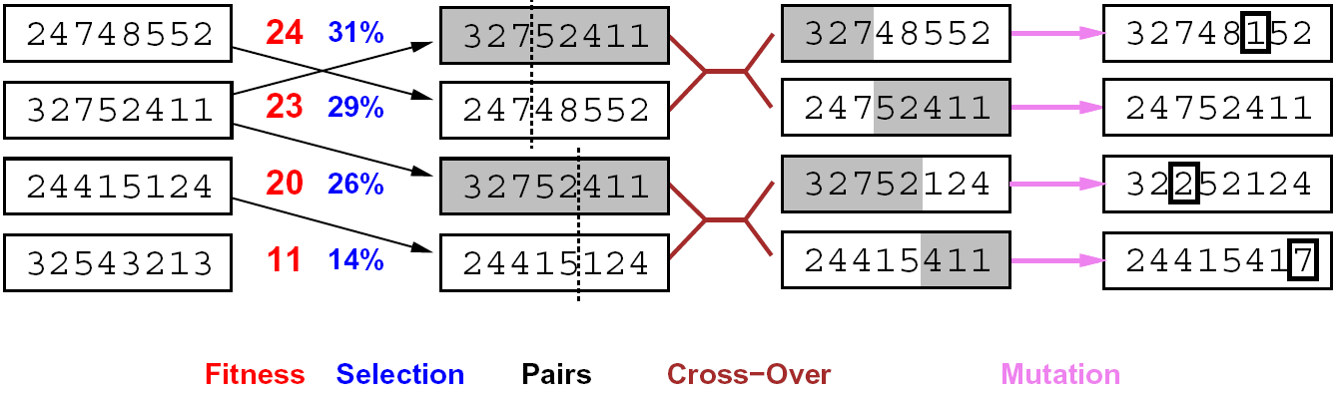
Genetic Algorithms
Genetic algorithms use a natural selection metaphor
  Keep best N hypotheses at each step (selection) based on a fitness function
  Also have pairwise crossover operators, with optional mutation to give variety

Slide 15
Travelling Salesman Problem (TSP)

Slide 16
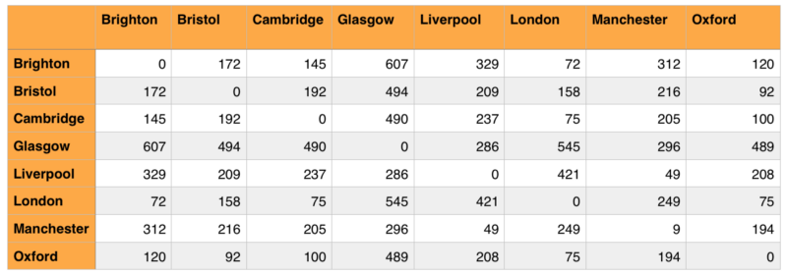
Traveling Salesman Problem (TSP)
[0, 4, 1, 2, 6, 5, 7, 3] =
["Brighton", "Liverpool", "Bristol", "Cambridge", "Manchester", "London", "Oxford", "Glasgow"]
The exact application involved finding the shortest distance to fly between eight cities without visiting a city more than once.
The table below shows the distances between each city in kilometers.

Slide 17
TSP – Initialization
Initialization
  Each individual featuring an integer representation of a route between the eight cities with no repetition.
  A corresponding array with the string equivalent of these indexes is created to output when a solution is found.
Fitness Function
  A fitness function calculates the total distance between each city in the chromosome’s permutation.
[0, 4, 1, 2, 6, 5, 7, 3] =
["Brighton", "Liverpool", "Bristol", "Cambridge", "Manchester", "London", "Oxford", "Glasgow"]

Slide 18
Consider the Traveling Salesman Problem (TSP) in which a salesman aims to visit n cities exactly once covering the least distance
Starting at any given node, choose from n–1 remaining nodes, then choose from n–2 remaining nodes, etc. Testing every possible route takes (n–1)! Steps
Use a genetic algorithm to evolve a near-optimal solution to the TSP
Label cities A, B, C, D, E, F, etc.
Example circuits: ABCDEF, BDAFCE, FBECAD
How do we perform crossover operations?
Basic crossovers might result in invalid members of the population
  e.g. combining ABCDEF and BDAFCE may result in ABCFCE

Slide 19
Another Example:
Traveling Salesman Problem (TSP)
The traveling salesman must visit every city in his territory exactly once and then return to the starting point; given the cost of travel between all cities, how should he plan his itinerary for minimum total cost of the entire tour?
TSP ∈ NP-Complete
Note: we shall discuss a single possible approach to approximate the TSP by GAs

Slide 20
TSP (Representation, Evaluation, Initialization and Selection)
A vector v = (i₁ i_{2…} i_{n}) represents a tour (v is a permutation of {1,2,…,n})
Fitness f of a solution is the inverse cost of the corresponding tour
Initialization: use either some heuristics, or a random sample of permutations of {1,2,…,n}
We shall use the fitness proportionate selection

Slide 21
TSP (Crossover)
Builds offspring by choosing a sub-sequence of a tour from one parent and preserving the relative order of cities from the other parent and feasibility
Example:
p₁ = (1 2 3 4 5 6 7 8 9) and
p₂ = (4 5 2 1 8 7 6 9 3)
First, the segments between cut points are copied into offspring
o₁ = (x x x 4 5 6 7 x x) and
o₂ = (x x x 1 8 7 6 x x)

Slide 22
TSP (Crossover-continued)
Next, starting from the second cut point of one parent, the cities from the other parent are copied in the same order
The sequence of the cities in the second parent is
9 – 3 – 4 – 5 – 2 – 1 – 8 – 7 – 6
After removal of cities from the first offspring we get
9 – 3 – 2 – 1 – 8
This sequence is placed in the first offspring
o₁ = (2 1 8 4 5 6 7 9 3), and similarly in the second
o₂ = (3 4 5 1 8 7 6 9 2)

Slide 23
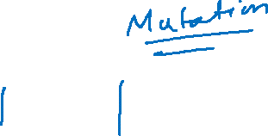
TSP (Inversion)
The sub-string between two randomly selected points in the path is reversed
Example:
(1 2 3 4 5 6 7 8 9) is changed into (1 2 7 6 5 4 3 8 9)
Such simple inversion guarantees that the resulting offspring is a legal tour

Slide 24
The Traveling Salesman Problem
Find a tour of a given set of cities so that
  each city is visited only once
  the total distance traveled is minimized

Slide 25
Representation
Representation is an ordered list of city numbers
1) London 3) Dunedin 5) Beijing 7) Tokyo
2) Venice 4) Singapore 6) Phoenix 8) Victoria
City List 1 (3 5 7 2 1 6 4 8)
City List 2 (2 5 7 6 8 1 3 4)

Slide 26
Crossover
Crossover combines inversion and recombination:
* *
Parent1 (3 5 7 2 1 6 4 8)
Parent2 (2 5 7 6 8 1 3 4)
Child (5 8 7 2 1 6 3 4)
This operator is called order-based crossover.

Slide 27
TSP (Crossover1)
Builds offspring by choosing a sub-sequence of a tour from one parent and preserving the relative order of cities from the other parent and feasibility
Example:
  p₁ = (1 2 3 4 5 6 7 8 9) and
  p₂ = (4 5 2 1 8 7 6 9 3)
First, the segments between cut points are copied into offspring
  o₁ = (x x x 4 5 6 7 x x) and
  o₂ = (x x x 1 8 7 6 x x)

Slide 28
TSP (Crossover2)
Next, starting from the second cut point of one parent, the cities from the other parent are copied in the same order
The sequence of the cities in the second parent is
9 – 3 – 4 – 5 – 2 – 1 – 8 – 7 – 6
After removal of cities from the first offspring we get
9 – 3 – 2 – 1 – 8
This sequence is placed in the first offspring
  o₁ = (2 1 8 4 5 6 7 9 3), and similarly in the second
  o₂ = (3 4 5 1 8 7 6 9 2)

Slide 29
TSP (Inversion)
The sub-string between two randomly selected points in the path is reversed
Example:
  (1 2 3 4 5 6 7 8 9) is changed into (1 2 7 6 5 4 3 8 9)
Such simple inversion guarantees that the resulting offspring is a legal tour

Slide 30
Mutation
Mutation involves reordering of the list:
* *
Before: (5 8 7 2 1 6 3 4)
After: (5 8 6 2 1 7 3 4)

Slide 31
Practice Question – TSP
Consider the problem of finding the shortest route through cities, such that each city is visited only once and in the end return to the starting city. Suppose we apply GA, in which genes represent links between pairs of cities.
  How many genes will be used in a chromosome of each individual if the number of cities is 10?
  For TSP problem, consider the following two routes as parents. Apply order based crossover on index 4 to 7 (index starts from 0).
  The mutation for TSP can be defined as a swap between two indices. Now apply mutation at index 5 and 6 on both parents.

Slide 32
